Slide 1

Bank Management System at United Institute of Technology
Name:-Shivam Pati Tripathi
Year:3rd
University Roll no.:-2202840100203

Slide 2

Index
Introduction …………………………………………………………………………………. 3
Methodology ……………………………………………………………………………….. 4
Flowchart ……………………………………………………………………………………… 5
Result/Snapshot …………………………………………………………………………… 6-8
Limitation ………………………………………………………………………………....... 9
Future Scope ……………………………………………………………………………….. 10
Reference ……………………………………………………………………………………. 11

Slide 3
Introduction
Robust application for basic streamlined banking operations.
Utilizes Java, AWT, Swing, and Oracle Database technologies.
Purpose and Significance:
Addresses the need for efficient and accessible banking services.
Provides a simple and intuitive platform for fundamental banking tasks.
Key Objectives:
User Authentication: Secure access through a reliable authentication process.
Account Management: Creation, modification, and retrieval of user account information.
Transaction Processing: Accurate handling of withdrawals and deposits.
User Interface: AWT and Swing for a user-friendly graphical interface.
Data Storage: Oracle Database for efficient and secure data storage.

Slide 4
Methodology
Define Project Scope and Objectives
Set Up Development Environment
Design Database Schema
Create User Interface
Implement User Authentication
Implement Account Creation
Implement Update Profile
Implement Transaction Functions
Implement Balance Check
Implement Sign Out
Test the System
Refine and Optimize

Slide 5
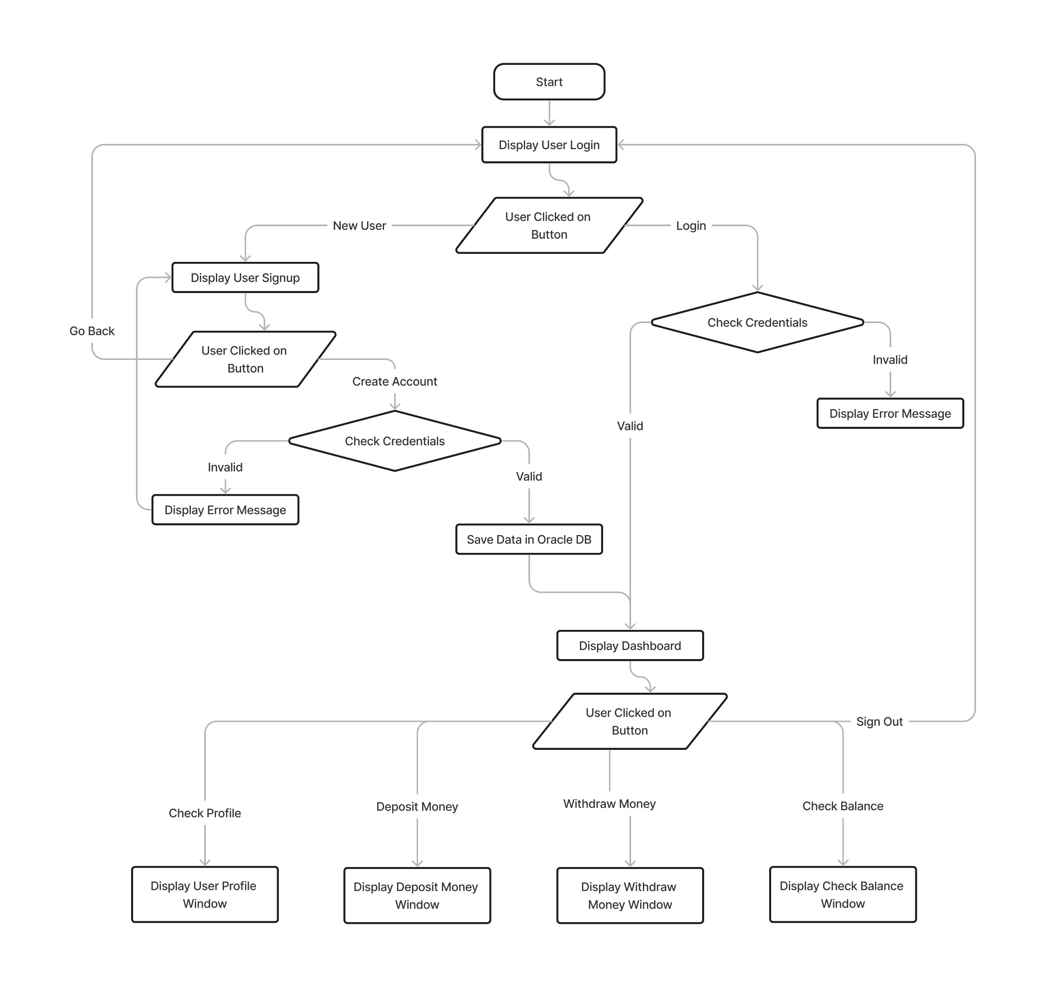
Flowchart

Slide 6
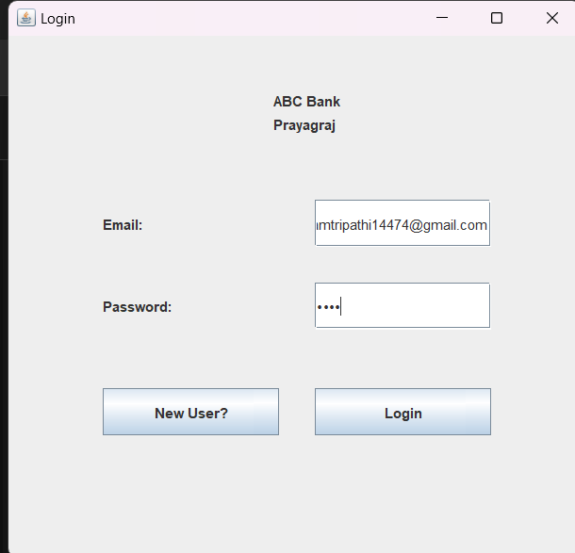
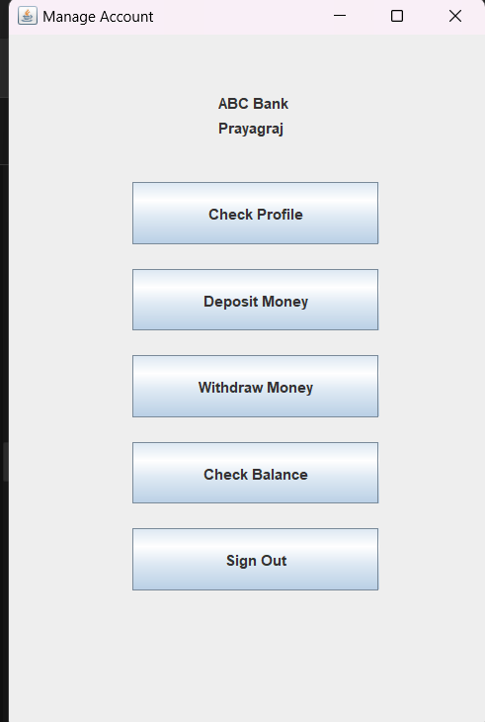
Results / Snapshots

Slide 7
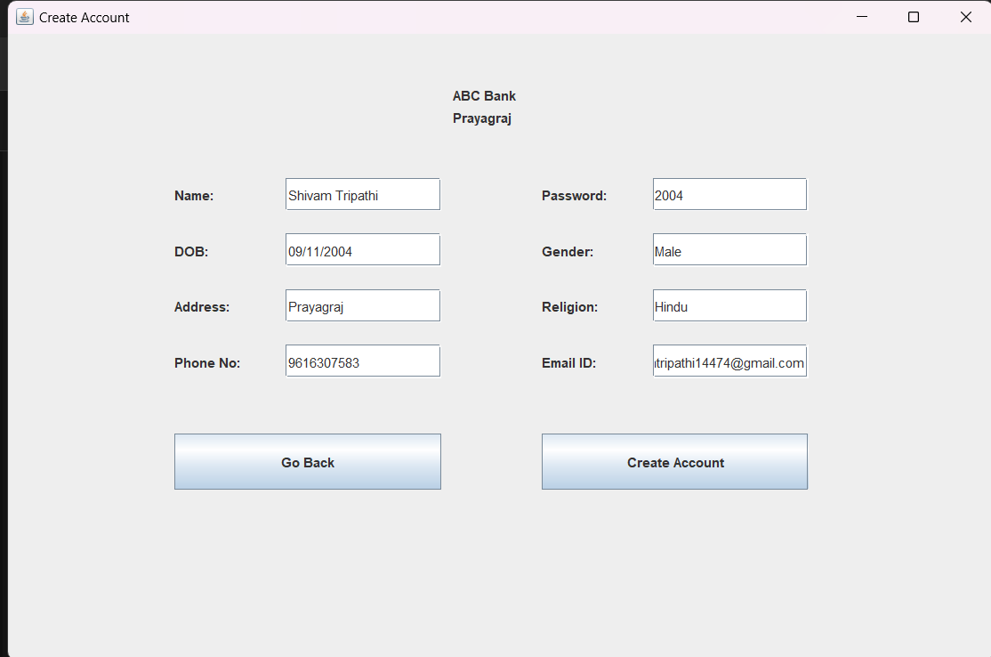
Results / Snapshots

Slide 8
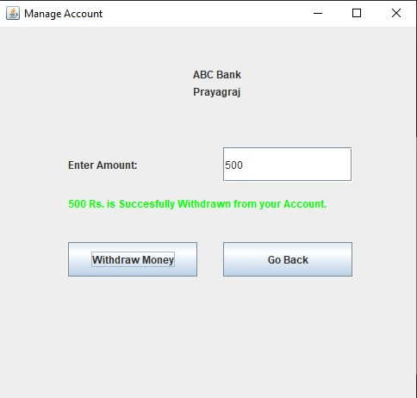
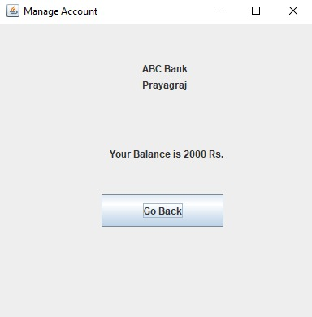
Results / Snapshots

Slide 9
Limitations
Security: Relies on basic authentication with no advanced security features; lacks encryption for sensitive data during transmission.
Scalability: Designed for small-scale use, potential performance issues in large-scale environments; may struggle with a high volume of concurrent transactions.
User Interface: Basic GUI lacks aesthetic appeal; provides limited user feedback in certain scenarios.
Database Security: Basic authentication for database access; lacks encryption and advanced access controls.
Transaction Processing: Does not implement advanced features like multi-step transactions or rollbacks; assumes a straightforward transaction flow.
Lack of Advanced Features: Focuses on fundamental operations, omitting features like funds transfer or account locking; no implementation of advanced user roles.

Slide 10
Future Scope
Enhanced Security Measures: Implement advanced security measures such as encryption for sensitive data during transmission and at the database level. Explore the integration of multi-factor authentication for an added layer of user verification.
Scalability: Optimize the system to handle a larger volume of concurrent users and transactions. Consider implementing load balancing and distributed architecture for improved scalability.
Advanced Transaction Processing: Incorporate advanced transaction processing features, such as multi-step transactions, transaction rollbacks, and transactional consistency.
Modern User Interface: Upgrade the graphical user interface using modern frontend frameworks and libraries for a more visually appealing and intuitive user experience. Incorporate responsive design for compatibility with a variety of devices.
Advanced Account Management: Implement additional account management features such as funds transfer between accounts, account locking, and account history tracking.

Slide 11
References
Javatpoint.com
Stackoverflow.com
Google.com

